Slide 1

Modern Application Development
Unit -1
Introduction

Slide 2
Syllabus
Unit 1-
Publishing and delivery of mobile applications
Requirements gathering and validation for mobile applications

Slide 3
Publishing Android Apps
Android application publishing is a process that makes your Android applications available to users.
It is the last phase of the Android application development process.
Once you developed and fully tested your Android Application, you can start selling or distributing
Android apps can be published in two ways
Using Google Play Store
Using own website.

Slide 4
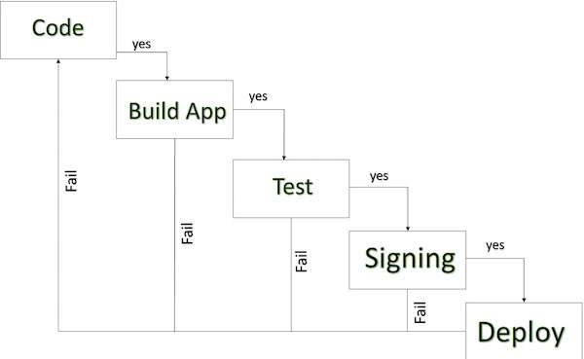
ANDROID DEVELOPMENT LIFE CYCLE

Slide 5
Check List before Publishing
Simplified check list which will help you in launching your Android application.
Regression Testing –Thoroughly test the application to meet the basic quality expectations for all Android apps, on all of the devices including phone and tablets. that you are targeting.
Application Rating- Specify a content rating for your app, which informs Google Play users of its maturity level. Currently available ratings are (a) Everyone (b) Low maturity (c) Medium maturity (d) High maturity.

Slide 6
Check List
Targeted Regions - Google Play lets you control what countries and territories where your application will be sold. Accordingly you must take care of setting up time zone, localization or any other specific requirement as per the targeted region.
Application Size - the maximum size for an APK published on Google Play is 50 MB. If your app exceeds that size, or if you want to offer a secondary download, you can use APK Expansion Files, which Google Play will host for free on its server infrastructure and automatically handle the download to devices.

Slide 7
Check List
SDK and Screen Compatibility - It is important to make sure that your app is designed to run properly on the Android platform versions and device screen sizes that you want to target.
Application Pricing Deciding whether you app will be free or paid is important because, on Google Play, free app's must remain free. If you want to sell your application then you will have to specify its price in different currencies.

Slide 8
Check List
Promotional Content It is a good marketing practice to supply a variety of high-quality graphic assets to showcase your app or brand. After you publish, these appear on your product details page, in store listings and search results, and elsewhere.
Build and Upload release-ready APK The release-ready APK is what you will upload to the Developer Console and distribute to users.

Slide 9
Check List
Finalize Application Detail Google Play gives you a variety of ways to promote your app and engage with users on your product details page, from colorful graphics, screen shots, and videos to localized descriptions, release details, and links to your other apps. So you can decorate your application page and provide as much as clear crisp detail you can provide.

Slide 10
Steps for publishing your app
The main goal when preparing your app for release is to make sure it is really ready. Android users expect high-quality apps that look great and work well. The high level tasks for publishing your app to the Google Play store are:
Prepare app for release
Generate signed APK
Upload to Google Play
Run alpha and beta tests
Publish to the world

Slide 11
What is an APK?
Android Application Package file → .apk file
It's like the executable
Each Android application is compiled and packaged in a single file that includes all the app's code, resources, assets, and manifest file
One need an APK to publish on Google Play

Slide 12
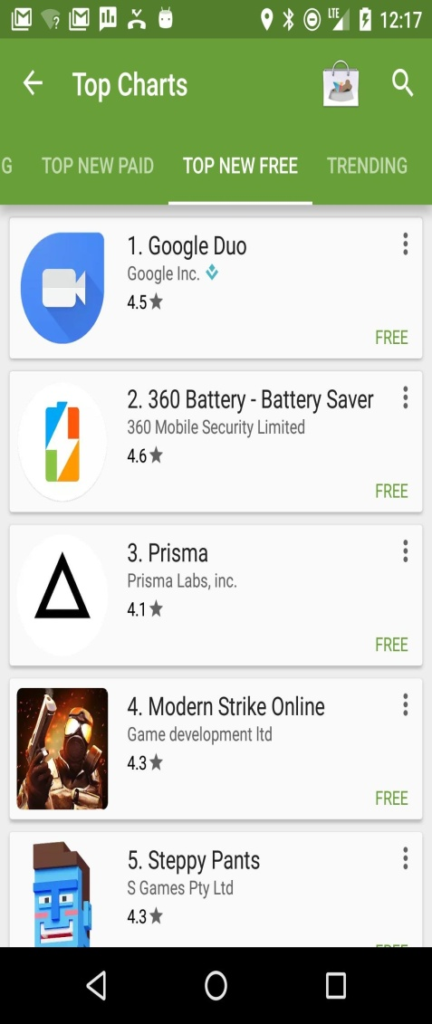
Share your app
Share your app during development
Zip it up
Share the source code
Publish to github
Make an APK
Share your production app
Publish on Google Play
Make an APK
Upload to Google Play
Run alpha and beta tests
Publish!

Slide 13
Before making .apk file
Test your app thoroughly.
Add an icon.
Make sure your app has the correct filters.
Choose an Application ID.
Specify API levels targets.
Clean up your app.
Generate a signed APK for release

Slide 14
Test, test, test!
First, make sure your app works correctly...
Test your app on different devices and screen size
Test your app on older devices
Use support library for backwards compatibility
Use alpha and beta tests to share your app with friends and family.
Test on real devices in a data center using the Firebase Cloud Test Lab-
Firebase Test Lab is a cloud-based app-testing infrastructure. With one operation, you can test your Android or iOS app across a wide variety of devices and device configurations, and see the results—including logs, videos, and screenshots—in the Firebase console.

Slide 15
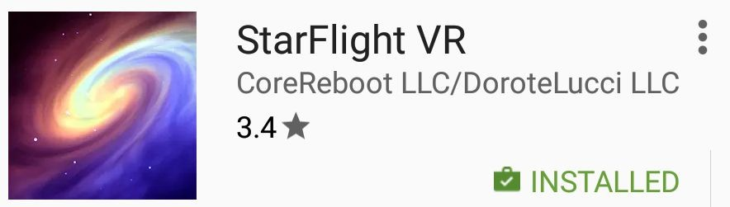
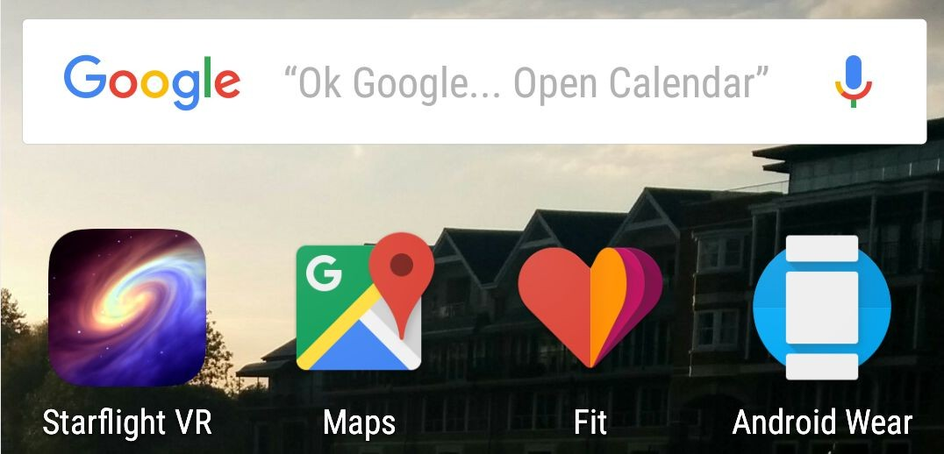
Add launcher app icon
The launcher icon appears in
Google Play
On the device
Home screen
Manage Applications
My Downloads

Slide 16
Google Play filters search results
Google Play search results only show apps that are compatible with the user's device.
If an app uses a finger print scanner, Google Play only shows the apps to devices that have a finger print scanner.
Types of filters
Hardware features
API level
Manifest settings such as
<supports-screens>
<uses-feature>
Countries (selected during APK upload)

Slide 17
Choose your Application ID
Application ID defines your application's identity
Must be unique across all apps from everyone!
If you change App ID and re-publish
The app becomes a different application
Users of the previous app cannot update to the new app
Initial Application ID is set to the package
You can change Application ID in build.gradle independently of package name

Slide 18
Specify Application ID in build.gradle
android { compileSdkVersion 23
buildToolsVersion "23.0.3" defaultConfig {
applicationId "android.mydomain.com.myappid"
...
}
...
Initial Application ID is same as package in Android manifest
}

Slide 19
Set min and target API level
minSdkVersion — minimum version of the Android platform that the app runs on
targetSdkVersion — API level that the app is designed for

Slide 20








Android versions
Codename |  | Version | Release Date | API Level
Honeycomb |  | 3.0 - 3.2.6 | Feb 2011 | 11 - 13
Ice Cream Sandwich |  | 4.0 - 4.0.4 | Oct 2011 | 14 - 15
Jelly Bean |  | 4.1 - 4.3.1 | July 2012 | 16 - 18
KitKat |  | 4.4 - 4.4.4 | Oct 2013 | 19 - 20
Lollipop |  | 5.0 - 5.1.1 | Nov 2014 | 21 - 22
Marshmallow |  | 6.0 - 6.0.1 | Oct 2015 | 23
Nougat |  | 7.0 | Sept 2016 | 24

Slide 21
Clean up your app
Remove logging statements
Disable debugging
Clean up your project directories
Update URLs for servers and services
Reduce APK size

Slide 22
APK size
Why does APK size matter?
The size of your APK affects:
how fast your app loads
how much memory it uses
how much power it consumes
Why reduce APK size?
Users might abandon "large" apps, particularly:
in areas with unreliable 2G and 3G networks
on devices that work on pay-by-the-byte plans

Slide 23
Reducing APK size
Remove unused resources
Reuse resources
Minimize resource use from libraries
Reduce native code
Reduce space needs for images

Slide 24
Reduce image sizes
Reduce animation frames
Use Drawable objects
Crunch PNG files
Use lowest quality and size JPEG files that look good
Use WebP File Format
Use vector graphics

Slide 25
Clean up project folders
Clean up project folders and files
Stray or orphaned files can prevent your application from compiling and cause it to behave unpredictably
Clean up jni, lib, and src folders
src: source files for your app (.java and .aidl files) NO jar files
lib: third-party or private library files, including prebuilt shared and static libraries (such as .so files)
jni: source files associated with the Android NDK, such as
.c, .cpp, .h, and .mk files

Slide 26
Clean up assets, resources, and tests
Remove unused private or proprietary data files
For example, delete unused drawable files, layout files, and values files from res/ folder
Review the assets and res/raw directories for raw asset files and static files to update or remove
Remove unused test directories

Slide 27
Generate signed APK for release
Android apps must be digitally signed before users can install them
Use Android Studio to generate and sign your APK

Slide 28
Digital certificates
A public-key certificate contains:
the public key of a public/private key pair,
other metadata identifying the owner of the key such as name and location
The owner of the certificate holds the private key.

Slide 29
Public and private key for app
When Android Studio signs the app, it creates the public certificate and the private key.
It attaches the public certificate to the APK.
You must securely store the private key in a keystore

Slide 30
Why you need to sign your app
The public-key certificate serves as as a "fingerprint" that uniquely associates the APK to you and your corresponding private key.
This helps Android ensure that any future updates to your APK are authentic and come from the original author.

Slide 31
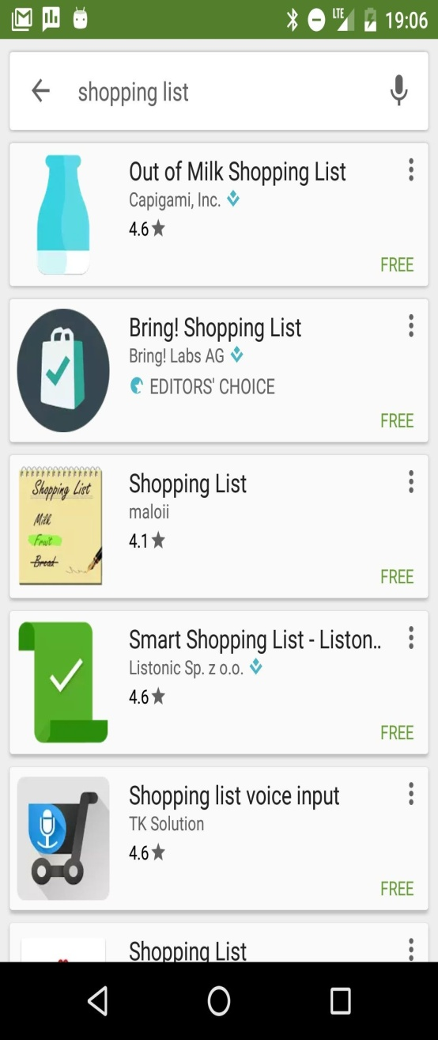

Publish your app!
Publish your Android apps on Google Play
Users can
search
download
review

Slide 32
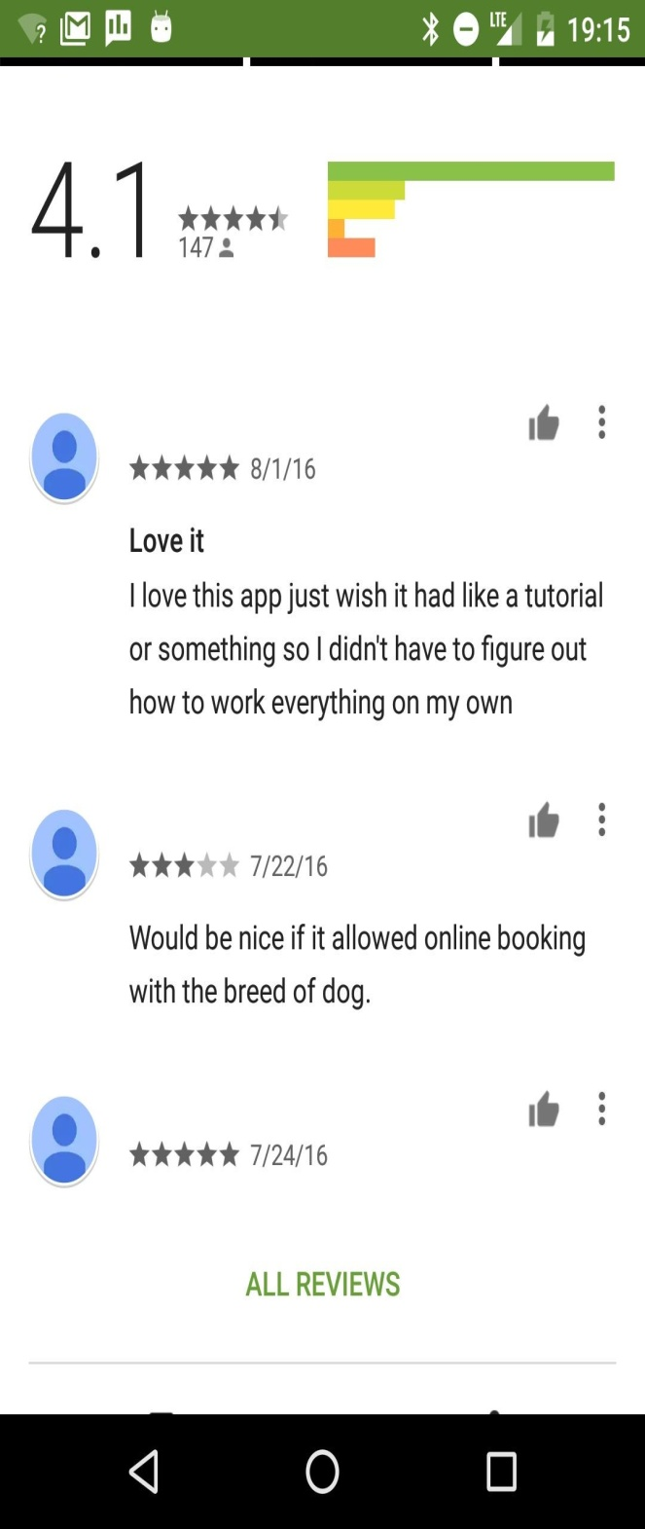
Users can review!
Make sure your app is ready before publishing to the world!
People will give you bad reviews if they are unhappy with it
The more they like it, the more they will want more features!

Slide 33
Steps to publish
Create an account on Google Play developer console
Create an entry for your app
Add the required assets and information
Run alpha and beta tests
Run pre-launch reports
Publish to the world!

Slide 34
Sign up for Google Play
Go to play.google.com/apps/publish/
Accept agreement
Pay the registration fee
Enter your details

Slide 35
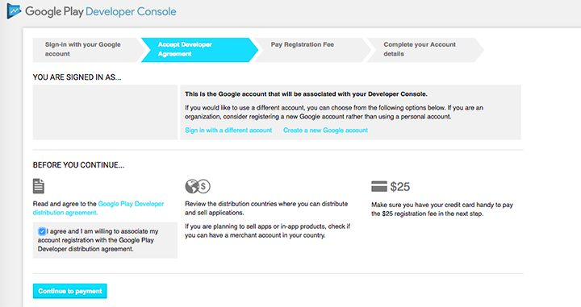
Google Play Developer Console
play.google.com/apps/publish/

Slide 36
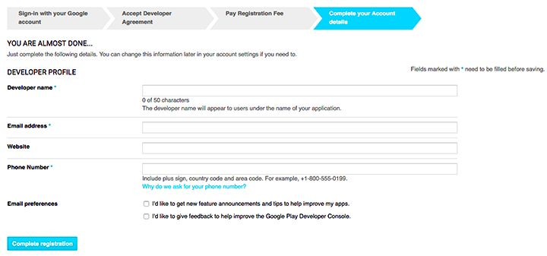
Enter your details
Name
Address
Website
Phone
Email
preferences

Slide 37
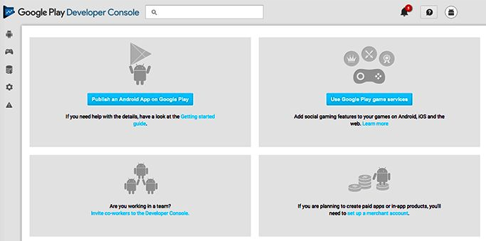
You're in!

Slide 38
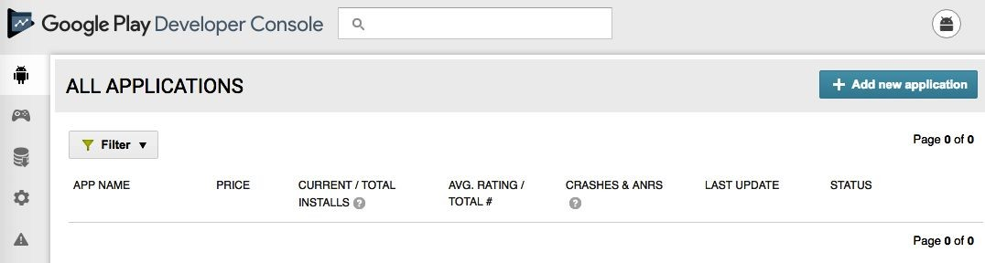
Add an application

Slide 39
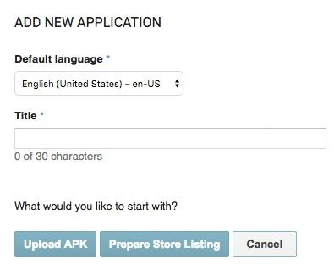
Add an application
Upload APK or
Prepare Store Listing
To run alpha and beta tests, upload the APK

Slide 40
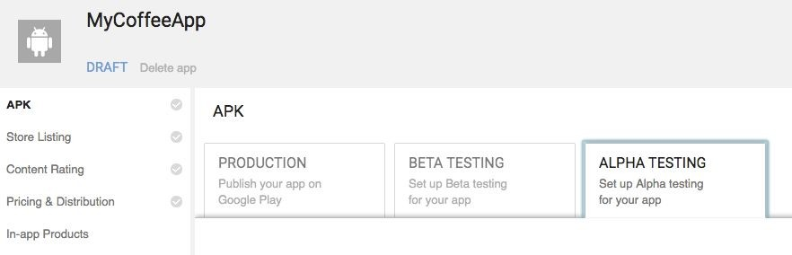
Run alpha and beta tests
Run alpha and beta tests in Google Play developer console

Slide 41
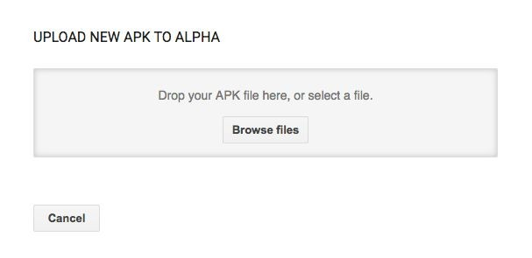
Choose file to upload

Slide 42
Why run alpha and beta tests?
Test your app before public release to help find and fix any technical or user experience issues
Get the bugs out before you release your app to the world!
Feedback from your test users does not affect your app’s public rating

Slide 43
Share with testers before publishing
Alpha test during development
Use alpha tests for early experimental versions of your app that might contain incomplete or unstable functionality
Beta test with limited number of real users
Use beta tests for apps that should be complete and stable

Slide 44
Alpha and Beta Testing
One can upload versions of your apps’ APK files and define a list of testers as a Google Group or Google+ Community.
Once this is done you’ll receive a URL that you forward to your testers, from which they can opt-in to the testing program.
Alpha testing group users are eligible for the alpha, beta, or production version of your app with the highest version code that is compatible with their device. Beta testing group users are only eligible for the beta or production version of your app with the highest version code that is compatible with their device.
There isn’t much difference between the two aside from the fact that you just start with a small number of testers for alpha testing and switch to a bigger group for beta

Slide 45
Alpha and beta tests
During alpha and beta tests
Your app is not listed in Google Play
Testers must have a link to get it
Testers cannot give reviews in Google Play

Slide 46
Closed beta
People have to be invited to join closed alpha and beta tests
Closed beta using email addresses
use lists of individual email addresses which you can add individually or upload as a .csv file
Closed beta with Google+ community or Google Group
You can move closed betas to an open beta while maintaining your existing testers

Slide 47
Open beta
Anyone with the link can join
Can scale to a larger group
You can limit max number of testers

Slide 48
Get feedback
Closed tests:
Provide a way for users to give feedback on your app, such as by email, website, or a message forum
Open tests:
Your testers can give private feedback in Google Play Store

Slide 49
Get private feedback for open betas
For open tests (alpha or beta) program, you can see and reply to user feedback in the Developer Console
Alpha and beta feedback from users is only visible to you and cannot be seen in the Google Play store

Slide 50
Opt in for pre-launch reporting
Pre-launch reports identify crashes, display issues, and security vulnerabilities
During pre-launch check, test devices automatically launch and crawl your app for several minutes
The crawl performs basic actions every few seconds on your app, such as typing, tapping, and swiping

Slide 51
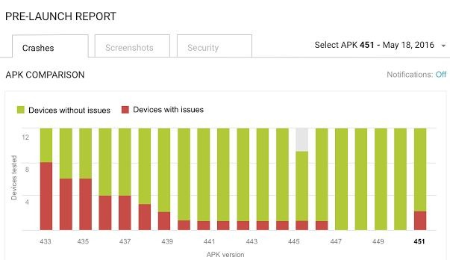
Example pre-launch report

Slide 52
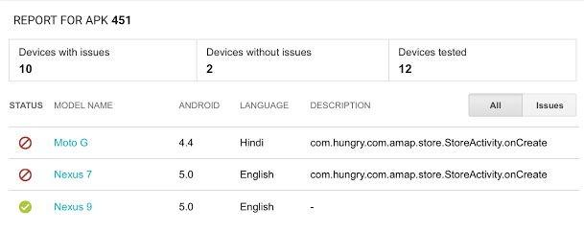
Example pre-launch report

Slide 53
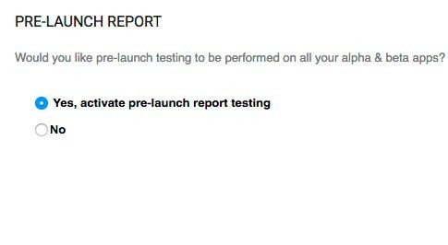
Running pre-launch reports
Opt-in to pre-launch reports in the console
Then when you upload or publish an alpha or beta APK, the pre-launch test runs automatically

Slide 54
Only publish high quality apps
Your app must meet core app quality requirements
Visual design and user interaction
Functionality
Performance and stability
Android users expect high-quality apps!

Slide 55
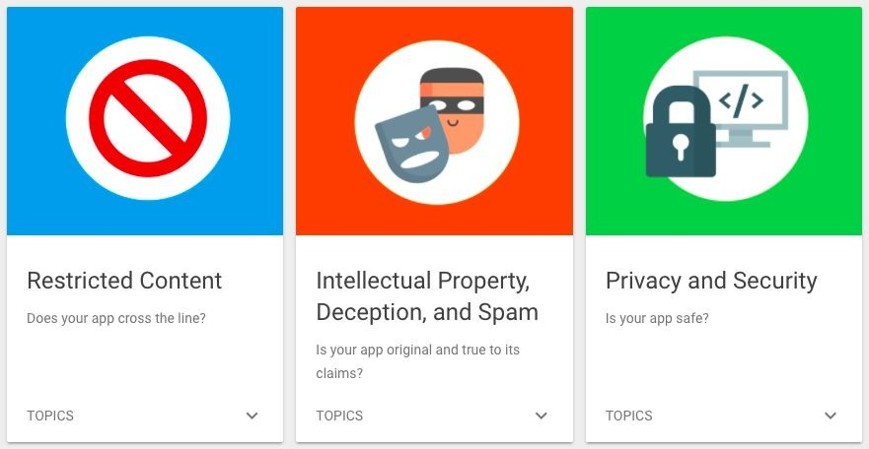
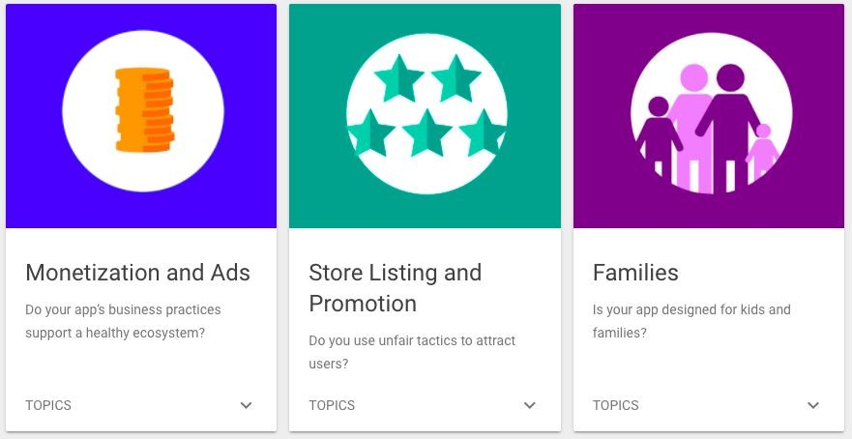
Comply with Google Play policies
Google Play policies ensure that all apps on Google Play provide a safe experience for everyone

Slide 56
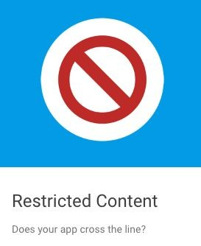
Restricted Content
Child Endangerment
Violence
Bullying & Harassment
Hate Speech
Sensitive Events
Gambling
Illegal Activities

Slide 57
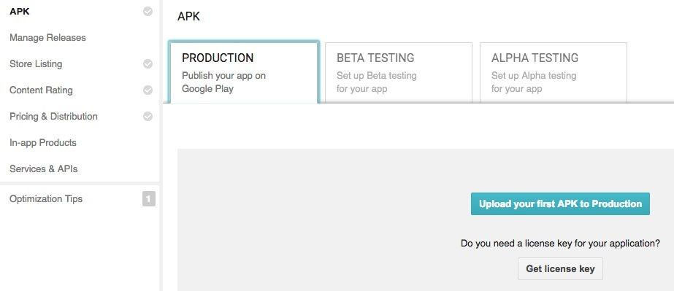
Upload your APK to Production

Slide 58

Check what's missing
add a high-res icon
add a feature graphic
add 2 non-Android TV screenshots
select a category
select a content rating
target at least one country
enter a privacy policy URL
make your app free or set a price for it
declare if your app contains ads
add a required content rating
Google Play tells you what is missing

Slide 59
Google checks your app
Automatic and manual checking
Your app can be rejected for violating any requirement
If you get rejected, fix the problem and try again

Slide 60
Requirements gathering and validation for mobile applications

Slide 61
Different methods to gather User requirements
Survey – By conducting a survey. Develop a questionnaire asking users various questions regards his needs and wants for the mobile application.
Reverse Engineering - One can reverse engineer an existing desktop application or web application to design and develop a mobile application.
Requirements Workshop- Requirement workshop can be conducted with intended users to understand what they want.
Prototyping – One can develop a prototype application to give the users idea what application looks like and has features.

Slide 62
Different methods to gather User requirements
Observation – One can observe various other similar apps.
Interview – One can conduct interviews with intended users to understand what they want.
Focus Group – One can have focus group to understand requirements of users
Document Analysis -One can study various documents available .
Brainstorming – One can brainstorming sessions with various stakeholders with discussion on implementation of mobile app’s key features with a clearer picture in their heads.
What is the USP (Unique Selling Point)?

Slide 63
Identifying and Understanding Design Requirements
When gathering the requirements for the development of a mobile applications there are a few important questions that need to be asked:
What is the use case? What is the purpose of the app and who is the end user?
Where will the data come from? Are there integrations to backend data sources? Is the information stored on on-premise servers or in the cloud? Payment gateways?
What level of security is required? Will there be sensitive data?
What type of notifications or contextual actions must the app be capable of?

Slide 64
Identifying and Understanding Design Requirements
What platforms will the app be on? iOS, Android, Windows, etc.?
Does the app need to access offline content?
Where will the app be hosted?
Will the app push or pull data from the phone like geo-location, calendar, weather data etc?
How many screens will be involved?
How will users be on boarded? Social registration? Self registration? Password Required? No Registration?
What type of reporting and analytics on user data, devices, etc needs to be collected?

Slide 65
Validation of Requirements
After you have answered these key questions then it is good to request a mock up of the wireframe.
Confirm your understanding of the feature & other app requirements with the client.
After this create a mock up and present in to the client along with a proposal for the job.
Sometimes the job will be sectioned off into phases with a pilot app that is used to test the app and acquire feedback and then a final version of the app

Slide 66
Requirement Specification
Once the user requirements and design requirements are understood, one should write down in a structured document for clear and unambiguous requirement specification.
One must pay attention to the technical details of the app.
It’s important for any development company to be aware of each and every technical aspect to implement your app the way it should be.
After all, you want it to be appealing and user-friendly for your future clients.
Make a detailed list, so no feature will be forgotten during the development stage.

Slide 67
Requirement Specification
The basic questions for this part are:
Briefly describe the mobile application concept.
What are the main business goals the application should help to reach?
What platforms do you want your app to run on? (IOS / Android, IOS – iPhone, OS – iPad, Android smartphone, Android tablet)
Who is the app to be aimed at? Describe your target audience.
What’s the concept for the app? Do you have any creative/design specifications for the application?

Slide 68
Requirement Specification
List the sections and features that will be included
Will the app be integrated with social media? List all social media channels you want your mobile app to interact with.
Will the app require data caching for offline work?
Do you plan the app to be compatible / sync with e-commerce engines, internal CMS, and other systems?
What about a prototype?

